Slide 1
JUNCTIONAL RHYTHM
A JUCTIONAL RHYTHM OCCURS WHEN THE HEART’S ELECTRICAL IMPULSES ORIGINATE FROM THE AV JUNCTION(AV NODE AREA) INSTEAD OF THE SA NODE.
IT ARISES WHEN THE SA NODE FAILS OR WHEN THE CONDUCTION FRON THE ATRIAL IS BLOCKED
RATE IS BETWEEN 40-60BPM(INTINSIC RATE OF THE AV NODE)
SLOWER THAN SINUS RHYTHM.
P WAVES OFTEN ABSENT,INVERTED,OR RETROGRADE(AFTER QRS COMPLEX).
QRS COMPLEX IS OF A NORMAL WIDTH
PR INTERVAL IS SHORT IF P WAVE IS PRESENT OR ABSENT IF NO P WAVE.

Slide 2
CAUSES OF JUNCTIONAL RHYTHM
SA NODE DYSFUNCTION(E.G SICK SINUS SYNDROME).
MYOCARDIAL INFARCTION(ESPECIALLY INFERIOR WALL).
MEDICASTIONS E.G DIGOXIN TOXICITY,BETA BLOCKERS.
INCREASED VAGAL TONE.
ELECTROLYTE DISTURBANCES

Slide 3
TYPES OF JUNCTIONAL RHYTHMS
THEY ARE CLASSIFIED BASED ON HEARTRATE AND CLINICAL CONTEXT BUT THEY ALL ORIGINATE FROM THE AV JUNCTION.

Slide 4
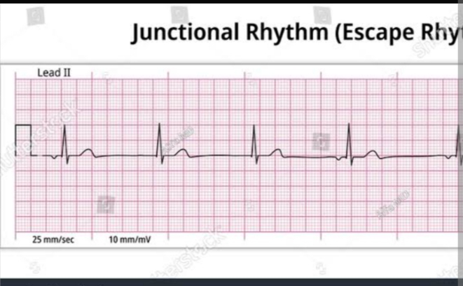
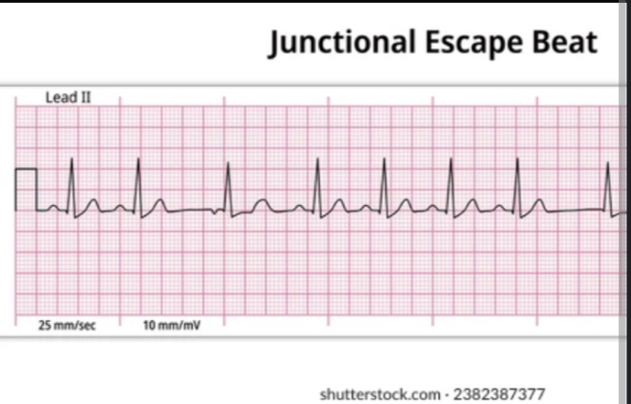
JUNCTIONAL ESCAPE RHYTHM
RATE IS BETWEEN 40-60BPM
IT COMES UP AS A RESULT OF THE TEMPORARY FAILURE OF THE SA NODE TO GENERATE IMPULSE
AFTER THE ESCAPE RHYTHM,YOU MIGHT HAVE A NORMAL SINUS RHYTHM .

Slide 5
OTHERS ARE AS FOLLOWS
ACCELERATED JUNCTIONAL RHYTHM -RATE IS BETWEEN 60-100BPM
JUNCTIONAL TACHYCARDIA-RATE ABOVE 100BPM.
JUNCTIONAL BRADYCARDIA-RATE BELOW 40BPM.
PREMATURE JUNCTIONAL RHYTHM-RHYTHM IS IRREGULAR.IT OCCURS BEFORE THE NEXT NORMAL BEAT

Slide 6
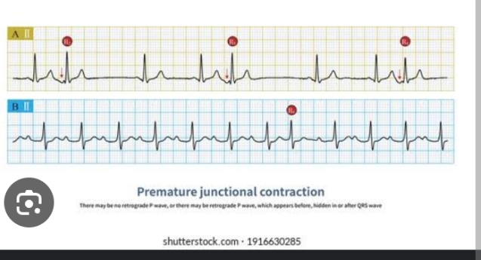
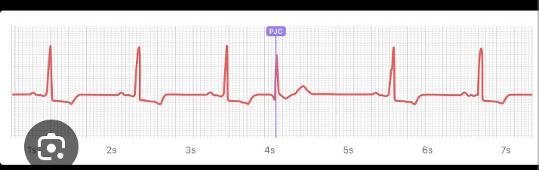
PREMATURE JUNCTIONAL RHYTHM

Slide 7
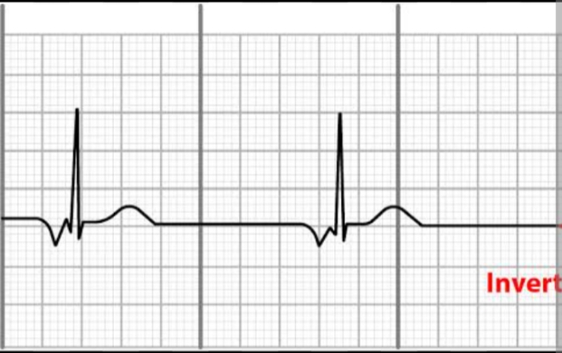
JUNCTIONAL RHYTHMS

Slide 8
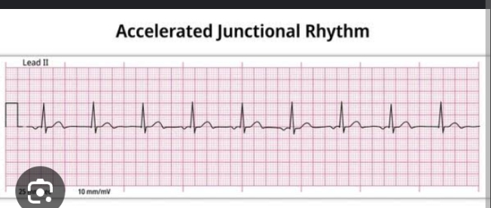
ACCELERATED JUNCTIONAL RHYTHM

Slide 9
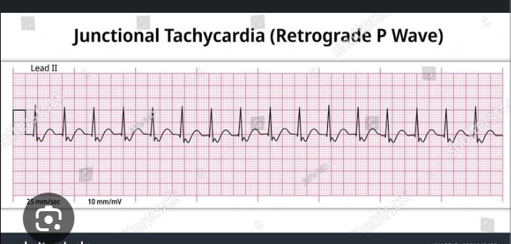
JUNCTIONAL TACHYCARDIA

Slide 10

THANK YOU FOR LISTENING

